Slide 1

Project Proposal for a Home Services Request App
A Simple Platform for Managing Home Repair Service Requests
SERVICE REQUEST APP FOR HOME SERVICES
HOME SERVICES
Team Members:
2520030367-K.Rishita
2520030594 — Pydi Devi Sree
2520030127 — Kallu Shrestha

Slide 2

PROJECT OVERVIEW
Customers Can Raise Service Requests Easily
Technicians Receive & Manage Assigned Requests
About The Application:
The proposed application provides a single platform where customers can request home repair services and technicians can manage those requests. Service information is kept organized and accessible for all users.
Customers Track Request Status In Real Time

Slide 3

PROBLEM STATEMENT
No Request Tracking Or Efficient Service Management
Current Challenges
Difficulty Finding Suitable Technicians Quickly
Home service management today is fragmented and inefficient. Customers struggle to find reliable technicians, requests are handled manually, and there is no easy way to track or manage service progress.
Manual Requests And Communication Gaps

Slide 4
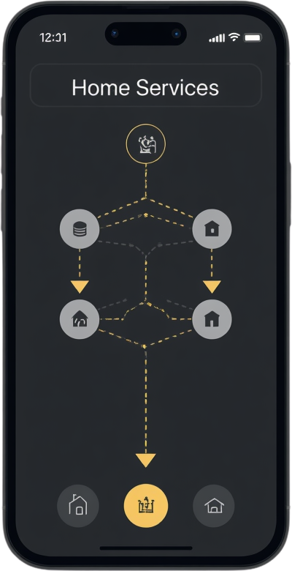
Customer Selects Service
PROPOSED SOLUTION
Request Raised & Technician Assigned
Centralized Mobile App
Service Started & Completed
A centralized mobile application connecting customers and technicians to manage the full service-request process from request to completion.
Customer Feedback Submitted

Slide 5



PROJECT OBJECTIVES
Simplify Service Requests
For Customers & Technicians
Connect Customers
With Technicians
Our Goals
• Manage service requests efficiently
• Provide a convenient user experience
• Track request status in real-time
A focused set of goals to deliver a seamless home-service experience for both customers and technicians.
Improve Communication
Across All Parties

Slide 6
SYSTEM MODULES
Grouped by User Type
Customer
Technician
Admin
CUSTOMER MODULE
TECHNICIAN MODULE
ADMIN MODULE
• Registration/Login
• View Services
• Raise Service Request
• Track Request
• Give Feedback
• Login
• Manage Profile
• View Assigned Requests
• Accept Request
• Update Request Status
• Manage Customers
• Manage Technicians
• Manage Services
• Manage Service Requests

Slide 7

Customer
DATABASE DESIGN
Key Concepts
Service Request
• MySQL stores structured data: customers, technicians, services & requests
• MySQL Workbench used for design and management
• Tables, Primary Keys, Foreign Keys & Relationships
Technician
Service (Type & Details)

Slide 8
BACKEND & API OVERVIEW
Flutter App → REST API → Node.js → MySQL
Layer 1
Layer 2
Layer 3
Layer 4
FLUTTER APP
(FRONTEND)
REST API
(INTERFACE)
NODE.JS
(BACKEND)
MYSQL
(DATABASE)
Cross-platform mobile UI built with Flutter & Dart. Sends HTTP requests: GET, POST, PUT, DELETE.
RESTful API layer bridges the mobile app and backend. Handles routing and request validation.
Node.js handles server-side logic, processes API requests, and manages business rules.
MySQL stores structured data: customers, technicians, services, and service requests.

Slide 9

AUTHENTICATION & REAL-TIME FEATURES
Login to Notification Flow
Step 1
Step 2
Step 3
Step 4
LOGIN & AUTHENTICATION
USER ACCESS
SERVICE REQUEST UPDATES
PUSH NOTIFICATIONS
JWT used for secure user authentication. Firebase handles login and real-time sync.
Authenticated users access customer or technician dashboards based on their role.
Real-time status updates on service requests synced via Firebase instantly.
Firebase Cloud Messaging (FCM) sends push notifications for request updates.

Slide 10

TECHNOLOGY STACK
Database & API & Auth
Frontend & Backend
DATABASE:
• MySQL – Structured data storage
• MySQL Workbench – DB design & management
API:
• REST API – App-to-backend communication
AUTHENTICATION / REAL-TIME:
• Firebase – Auth and real-time services
• JWT – Secure authentication tokens
• FCM – Push notifications
FRONTEND:
• Flutter (Dart) – Cross-platform mobile app
BACKEND:
• Node.js – Server-side JavaScript runtime
STATE MANAGEMENT:
• Provider / Riverpod – Flutter state management
PLATFORMS:
• Android and iOS – Target mobile platforms

Slide 11
EXPECTED BENEFITS & FUTURE SCOPE
What This Application Delivers
Expected Benefits
• Easy service requests for customers
• Better customer-technician communication
• Simple and transparent request tracking
• Organized service management
• Faster status updates
• Convenient user experience
Future Scope
• Online payment integration
• GPS-based technician tracking
• In-app communication features
• Advanced analytics dashboard
• AI-based service recommendations

Slide 12
Service Request App
Smarter Service Requests. Better Home Services.
THANK
YOU!
Simplifying Home Repair, One Request at a Time.

